Slide 1
REINFORCEMENT LEARNING
Main reference: Lapan, M. (2020). Deep Reinforcement Learning Hands-On: Apply modern RL methods to practical problems of chatbots, robotics, discrete optimization, web automation, and more. Packt Publishing Ltd.

Slide 2

















Artificial intelligence and Machine learning

Slide 3
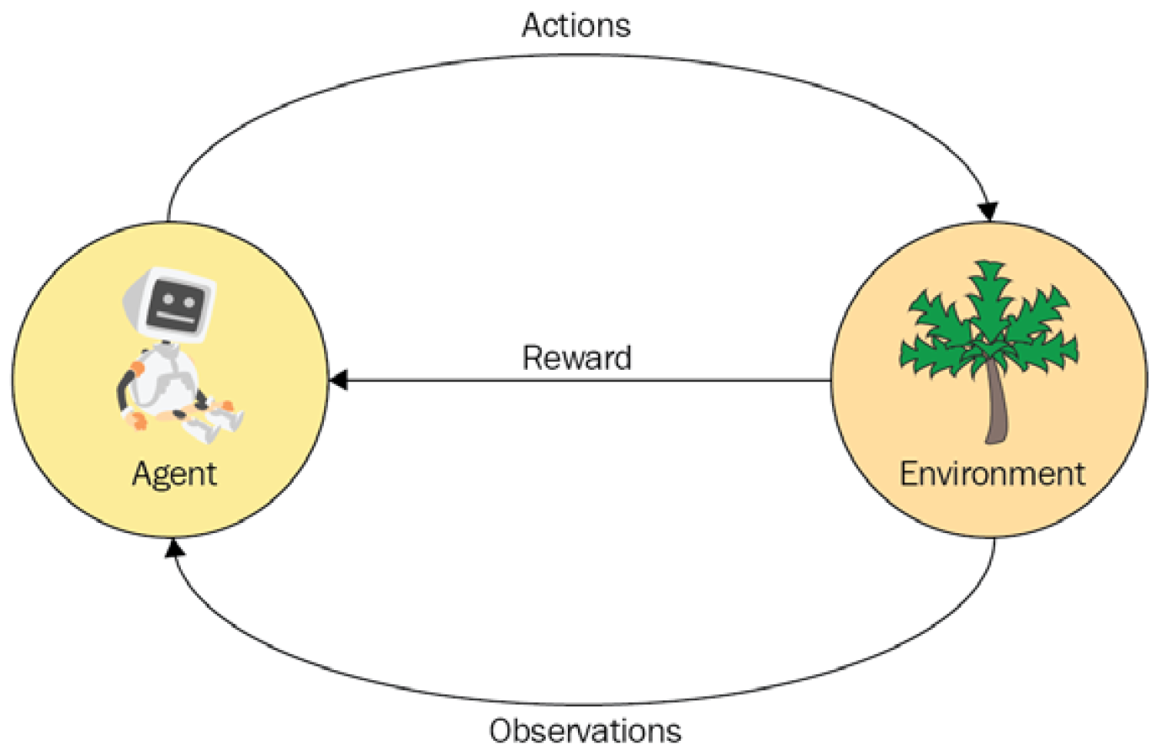







Image: (Lapan, 2020)

Slide 4
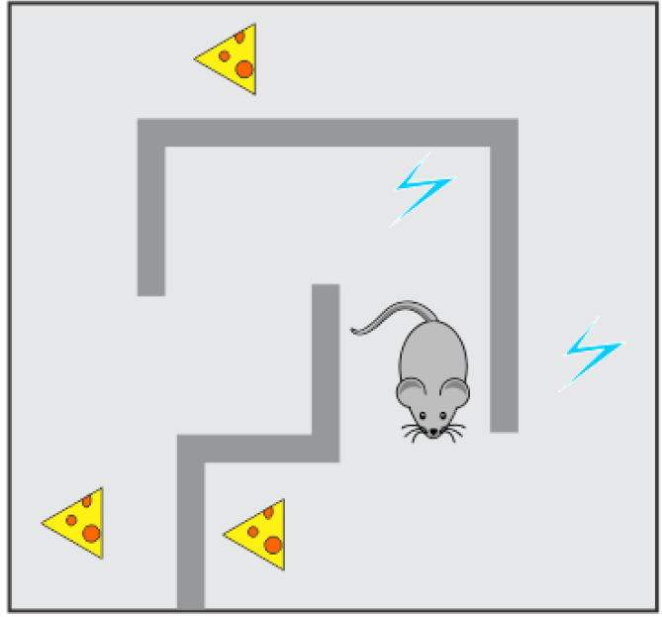












Image: (Lapan, 2020)

Slide 5







How hard reinforcement learning (RL) is?

Slide 6


How hard reinforcement learning (RL) is?

Slide 7
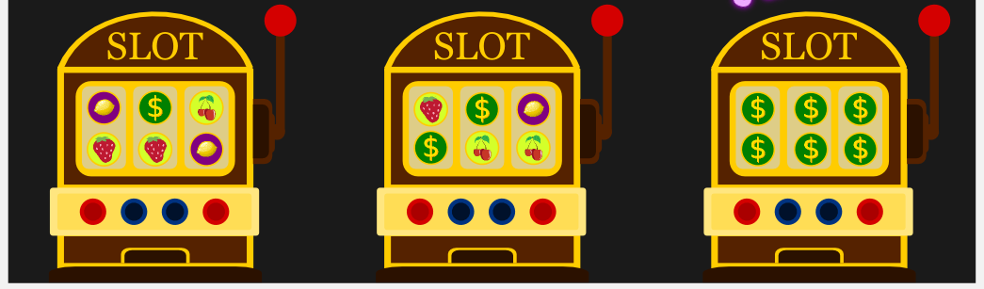



How hard reinforcement learning (RL) is?
Image: medium.com/10x-curiosity
Multi-Armed Bandit problem

Slide 8









How hard reinforcement learning (RL) is?

Slide 9
OpenAI Gym

